Slide 1
Working with Images
CMM201 – Programming Concepts for Business Analytics
Week 9
Dr Carlos Moreno-Garcia

Slide 2
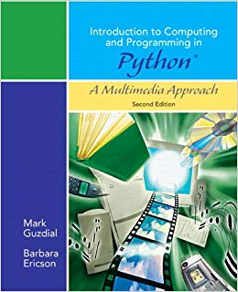
Why?
Images (and multimedia in general) are easy to understand analogies of data!
Allow you to understand data input/output in an easier way.
Is more visual!

Slide 3
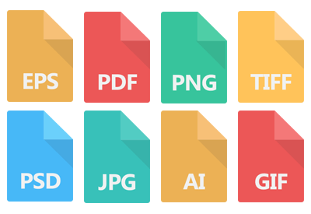
How does an image look “digitally”?
As you may know, there are many image file extensions:
jpeg
png
tiff
etc.
These are just some of the many compression algorithms that exist to convert an image into a file.

Slide 4
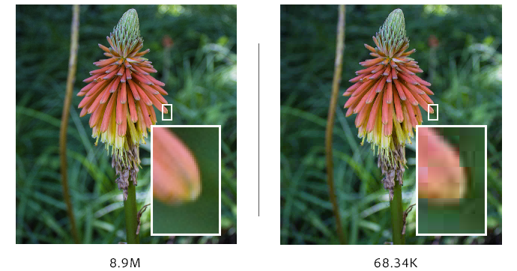
Compression
The “art” of compression algorithms is in quantization!
The best algorithms are the ones who achieve the best visual quality of the image once this is not analogue anymore.
However, that is NOT our problem!
We just want to work with the image as a pixel array.
We are going to work with images in a simpler, uncompressed way…

Slide 5
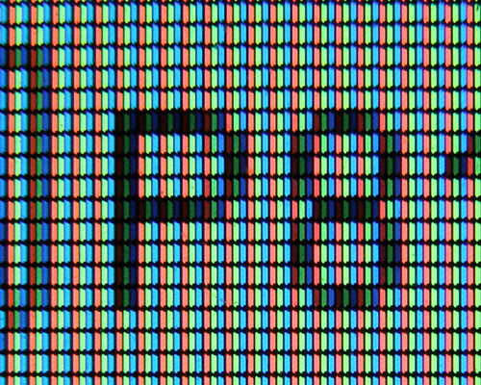
As numpy arrays!
Well, as arrays/matrices (in a more general sense…)
When we visualise an image, in reality what we are looking at is a bunch of pixels arranged in our screen.
Each of these pixels has a different pixel value, which indicates the colour at that given positions.

Slide 6
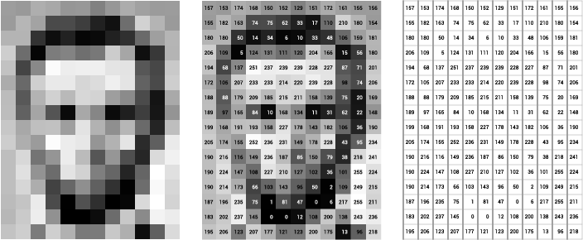
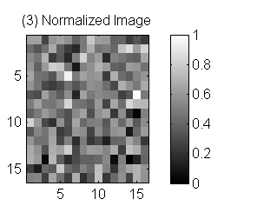
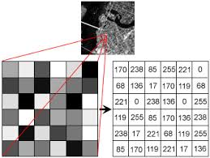
Grayscale images
A 2D-grid of pixels.
Two ways to represent grayscale:
Standard: from 0 (black) to 255 (white).
Normalised: from 0 (black) to 1 (white).
Can you convert between standard↔normalised?

Slide 7
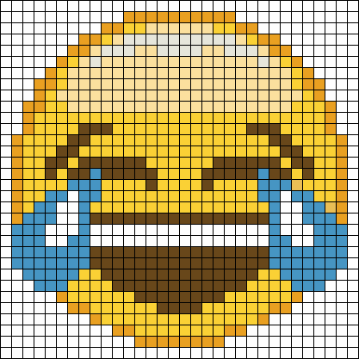
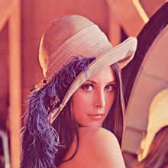
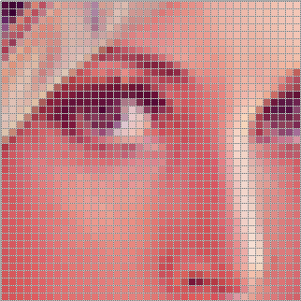
What about colour images?
Do you know who she is?

Slide 8
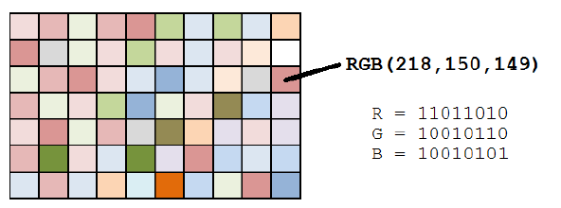
Colour Images
Each pixel has three values (also called channels):
Red
Green
Blue
That’s why images with colour are often called RGB images.
If this image is imported in Python, the pixel in row 2-column 9 has a value of 218 in the red channel, 150 in the green channel and 149 in the blue channel.
This value would be stored in a tuple.
0 1 2 3 4 5 6 7 8 9
0 1 2 3 4 5 6
How many colours can be represented using the RGB standard?
Is there another standard that can represent more colours?

Slide 9
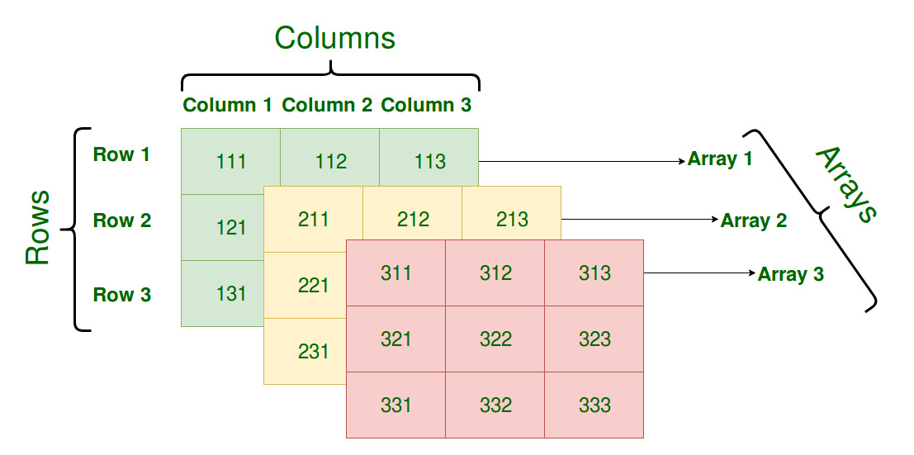
Colour Image Representation in numpy
To import an colour image in a numpy array, we would have two options:
A two dimensional array where each position contains a tuple.
This is possible! Last time we stored strings in numpy arrays.
Problem: Calculations would be harder to do.
A three dimensional array with layers.
(211,211,111) | (212,212,112) | (213,213,113)
(221,121,121) | (222,222,122) | (223,223,123)
(231,231,131) | (232,232,132) | (233,233,133)

Slide 10
How would you “query” a certain pixel using numpy array terminology?
Note: These are not the values, these are the positions!

